Slide 1
Transfers & Advances
January 11, 2024
NWOCA Training

Slide 2
What are Transfers & Advances?
TRANSFERS
Movement of monies from one fund to another permanently.
No anticipation of returning these monies from revenues received.
ADVANCES
Monies given/received with the intent to repay the fund that advanced the monies.

Slide 3
Examples
Examples of Transfers
Transfer from Class of 2023 to Class of 2024
Old fund balances to general fund with approval.
Cafeteria fund to cover negative balance
Examples of Advances
Athletic Funds– Advance monies, but the ticket sales received will repay the advance.

Slide 4
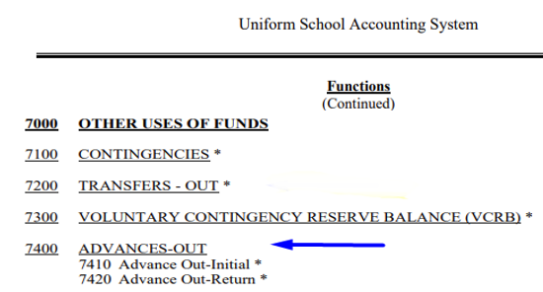
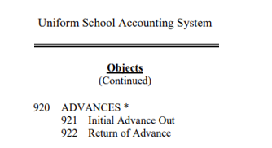
USAS Manual – Advances Expenditure Function & Object Codes

Slide 5
USAS Manual – Advances Revenue Accounts

Slide 6
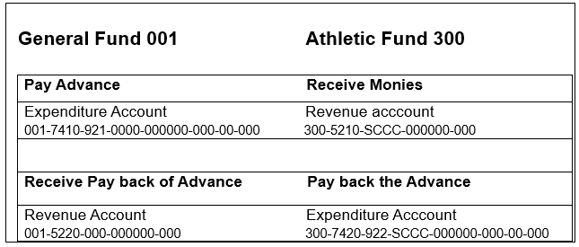
Advance Example
General Fund (001) advancing monies to Athletic Fund (300)

Slide 7
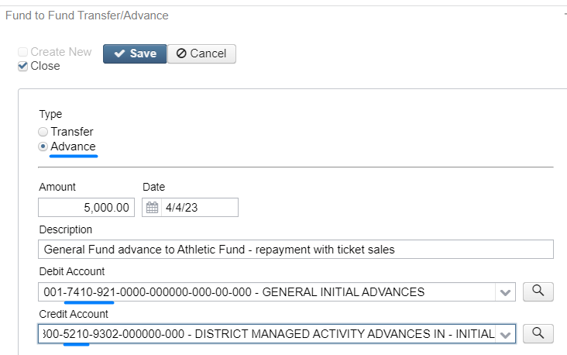
Transaction in USAS – Advance monies

Slide 8
Finding Outstanding Advances to be Repaid
Add column REPAYABLE to Transfer/Advance Grid
Filter using Repayable column = True
View the Advance that can be repaid
Click the in the Repayment section to create transaction to repay the Advance. Any previous repayments will show.

Slide 9
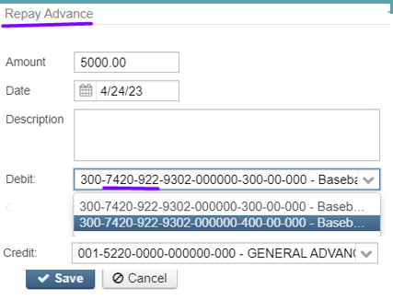
Transaction in USAS – Repay Advance
Drop Down will show the available accounts to choose.

Slide 10
Repayment Transaction
If the correct Account to repay the Advance does not exist, when the user clicks on to create the Repayment transaction, the user will receive the following error message:
User must then create the correct Account under Core < Accounts < Expenditure.

Slide 11
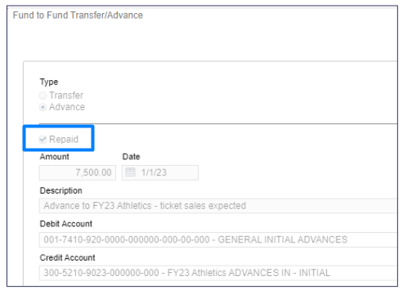
REPAYMENT of ADVANCE(s)
Will checkmark Advance Repaid

Slide 12
REPAYMENT of ADVANCE(s)
It is up to the district to know how the Advance is to be repaid.
Repayment guidelines are not determined by the software.
For example, per the Auditor of State's office, if the advance will not be repaid in a reasonable time, the advance should be processed as a transfer.

Slide 13
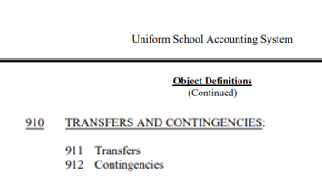
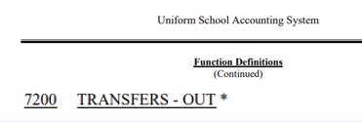
USAS Manual – Transfer Expenditure Function & Object Codes

Slide 14
USAS Manual – Transfer Revenue Accounts

Slide 15
Transfer Example
General Fund (001) Transferring monies to Cafeteria fund (006) in order to cover negative balance.

Slide 16
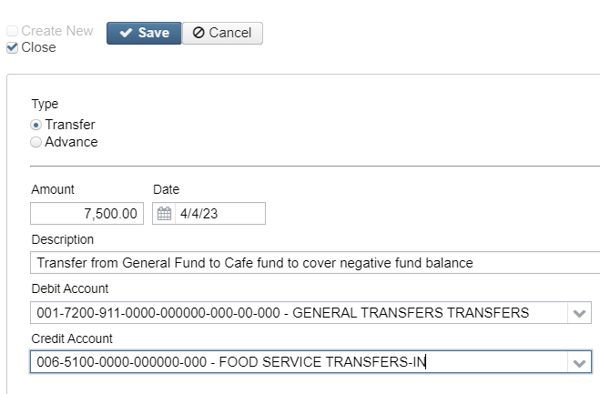
Transaction in USAS – Transfer

Slide 17
Delete Transfers & Advances
Transfers/Advances from a prior fiscal year cannot be deleted.
Transfers/Advances must be in Open Posting Period if it is to be deleted.

Slide 18
Account Impacts – Transfer/Advance IN
Transfer or Advance INTO an account will be added to the Received amount while increasing the Fund balance.

Slide 19
Account Impacts – Repay Advance
Repayment of Advance FROM an account will be added to the Expended amount while decreasing the Fund balance.

Slide 20
REPORTS
SSDT Cash Summary - Expended and/or Received
SSDT Budget/Appropriation Summary - FYTD Expended
SSDT Revenue Summary - FYTD Received
SSDT Transfer Advance Summary
Summary with totals only.
Shows the Initial Advances, but not the repayments.
SSDT Transfer Advance Activity
Detail of transfer/advance transactions.
Will show the Repayments of Advances. **see page 23

Slide 21
SSDT Transfer Advance Summary Report
Shows Transfers/Advances In/Out, variances, but not the repayments.
With SUMMARY box checked – totals only.

Slide 22
SSDT Transfer Advance Activity Report
Created to help review Transfer & Advance Activity and repayments.
Currently set up to show LEGACY Repayments from Classic software.

Slide 23
SSDT Transfer Advance Activity Report
To get Redesign repayments of Advances on a report, refer to Public USAS Reports Library under the Transaction-Based Reports section for report definition. USASR-5156-Transfer Advance Activity Report to add missing (Redesign) repayment Transaction Type

Slide 24
Questions ?

